Slide 1


D.Y.Patil college of engineering & technology, kasaba bawada, kolhapur
Department of Computer Science & Engineering Academic Year 2025-26
STUDENT DOCUMENT SECURITY SYSTEM
Presented by : Snehal Tanaji Khot
Roll.No. : 45

Slide 2



Introduction
In today’s digital world, student documents are increasingly stored and shared online.
Unauthorized access and document tampering can lead to serious misuse of academic and personal records.
Ensuring document security and user authentication has become highly important.
Therefore, a secure system using blockchain technology is relevant to provide tamper-proof storage and safe access control.

Slide 3


Problem Statement
Student documents are not securely stored in many systems. Accounts can be accessed without strong security alerts.
Verification process is slow and manual.
Need for a secure and tamper-proof digital solution.
Existing Issues
No login notification system.
No proper document tampering detection.
Manual verification consumes time.
Current Challenges
Ensuring secure user authentication. Protecting sensitive student data.
Providing fast and reliable verification. Integrating blockchain with cloud storage efficiently.

Slide 4




Proposed Solution
Develop a secure web-based system with email and password authentication.
Send email notifications to students on every login attempt.
Allow students to upload and manage all their important documents.
Generate a SHA-256 hash for each uploaded document.

Slide 5
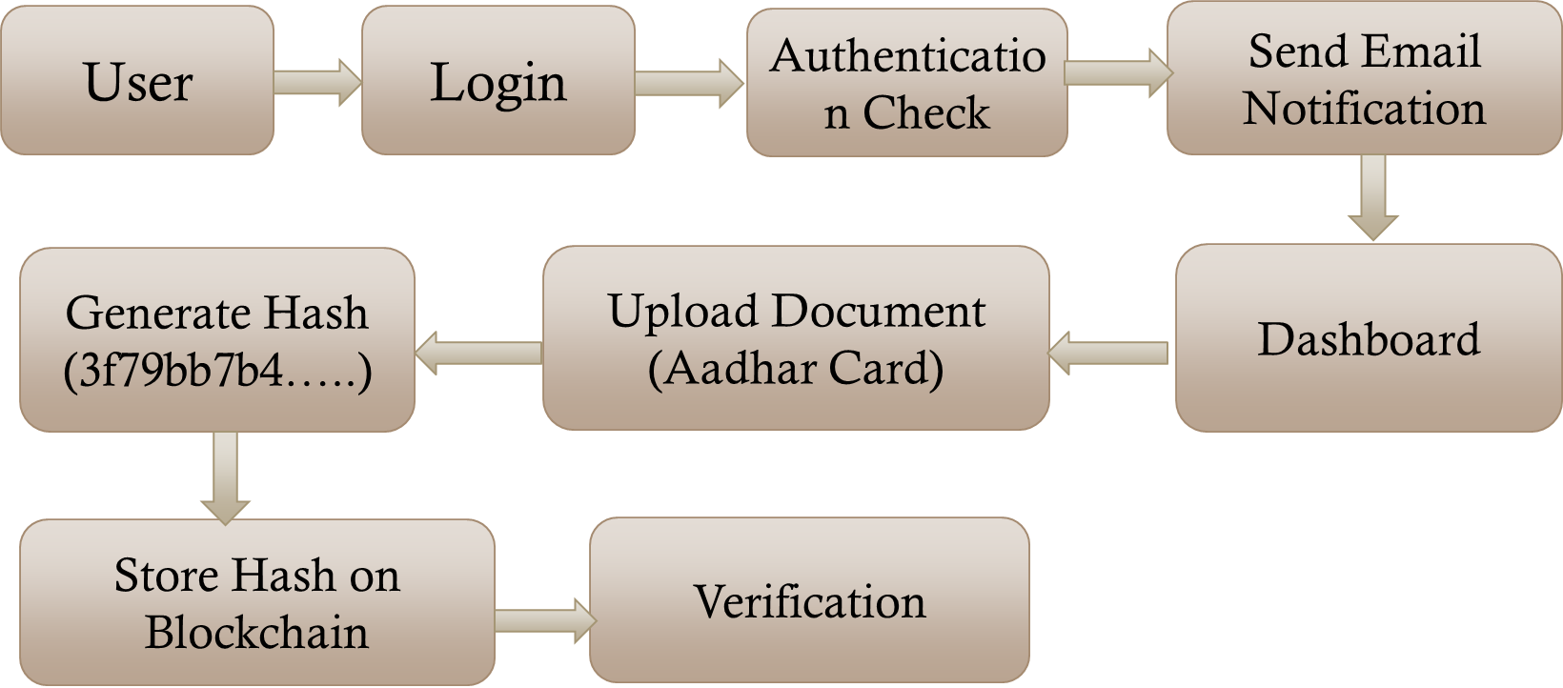
System Architecture

Slide 6
Technology Used
HTML, CSS, JavaScript – To create the website.
Firebase – For login, database, and storing documents
SHA-256 – To generate a unique code (hash) for each document.
Ethereum Blockchain – To store document hash securely Solidity – To write the blockchain program.

Slide 7



Advantages
Strong login protection Instant login alert
Secure document storage Prevents tampering Transparent verification User data privacy

Slide 8
Future Scope
QR code verification Mobile application
Multi-university integration Two-factor authentication
AI-based document categorization Government portal integration
70%

Slide 9


Thank you

